Slide 1

Advanced Programming Using Python
Anjali Kulkarni
Sept 2024

Slide 2
Day 1
2 Sept 2024

Slide 3
A bit about myself ☺
Education - B.E. - Cummins College of Engineering, Pune
18 years of industry experience
Writing code to test code
Technologies - Java, Python, perl, various tools for QA Automation
Domains - Healthcare, Banking, Security, Advertising, Genomics
Actively exploring and pursuing my passion

Slide 4
Agenda
Introduction - Python
Setup
Install Python
Install IDE
Python Basic Syntax
Quiz

Slide 5
Introduction - Python
Created by Guido van Rossum in 1991
Open Source, Free
Simple and readable
Minimalist
Cross-Platform compatible
Dynamically Typed variables
Object-Oriented
High-level, interpreted

Slide 6
Execution of programming languages
Translates source code into machine code
Compiler : Translation before program is run
Eg: C, C++, C#
Interpreter : Translation line-by-line, executing each line as it goes
Eg: Python, Javascript, Ruby, PHP
Hybrid / JIT : Translation to bytecode, interpretation at runtime, by JVM.
Eg: JavaA

Slide 7
Compiler vs Interpreter
Compiled Languages | Interpreted Languages
Translate directly to machine codes | Translation and execution on the fly
Needs entire program | Line by line execution Can start executing as soon as it starts reading
Creates an exe, native and fast | Slower than compiled languages
Usually statically typed Types known during compilation | Usually dynamically typed
Change in type : recompilation | Non-syntax errors are detected only in run-time
Ideal for compute-heavy and efficiency-intensive tasks | Ideal for small tasks
C, C++, FORTRAN | Python, Perl, PHP, Bash
System Software, games | Scripting, Web development, Data Analytics, visualisations

Slide 8

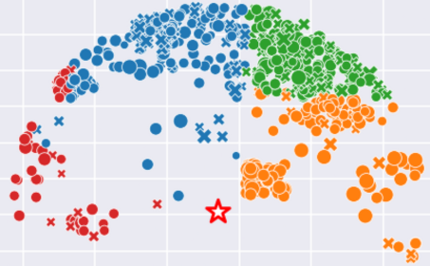
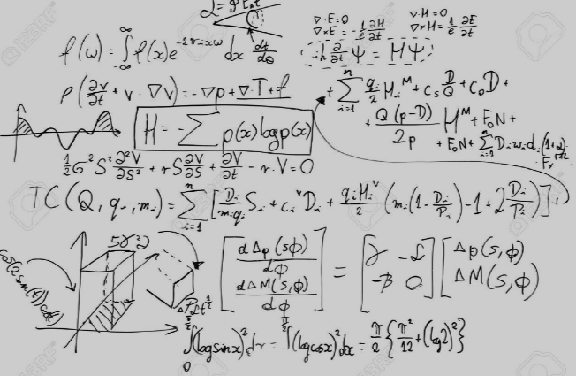

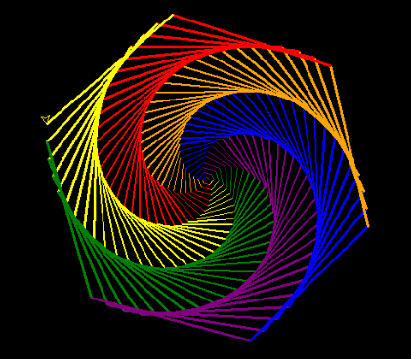
Python Applications
AI Applications
Data Visualisation
Solve Complex Maths Problems
Building Websites
Graphics

Slide 9
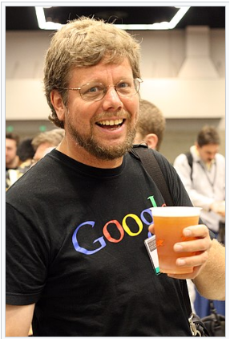
Words of the author!!
“Python is an experiment in how much freedom programmers need. Too much freedom and nobody can read another’s code; too little and expressiveness is endangered.”
- Guido van Rossum

Slide 10



First things first!
Setup :
Anaconda.com/download
Enter email id and get download link
Download windows installer
Follow instructions on installer
IDE :
PyCharm
Visual Studio Code
Jupyter Notebook
IDLE
Spyder

Slide 11
Test your installation!
Hello world !!

Slide 12
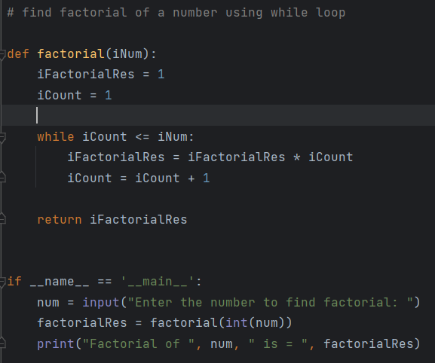
Python Basics (mainExplain1.py, mainExplain2.py)
Indentation
Case sensitive
_ _main_ _

Slide 13
Datatypes
Fundamental datatypes
Custom Types - Classes
Specialized types - Modules
None

Slide 14
Fundamental Datatypes (Variables.py)
Numeric Types
Integer
Floating-point
Complex
Sequence Types
String
List
Tuple
Set
Frozen set
Range
Mapping Type
Dictionary
None Type
None (null)
Boolean Type
Boolean
binary Types

Slide 15
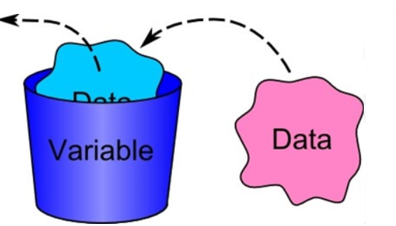
Variables (Variables.py)
Placeholders that allow you to store, modify, retrieve data during execution of a program
Variable Assignment
Dynamic Typing
Reassigning Variables
Multiple assignments
Constants
Dunder variables

Slide 16
Naming conventions
Variable names must start with a letter or an underscore (_), but not a number
Variable names can contain letters, numbers, and underscores (_)
Variable names are case-sensitive: myVar and myvar are different
Avoid using Python keywords (like if, for, while) as variable names

Slide 17
Hands on
Assignment 1: Declare variables of integer, float, boolean and String type and print their values
Assignment 2: Swap values

Slide 18
Operators (Operators.py)
Special symbols or keywords used to perform operations on variables and values
Arithmetic Operators
+, -, *, /, %, //, **, BODMAS
Assignment Operators
=, +=,-=,*=,/=,%=,**=,//=
Bitwise Operators
&,|,^, ~, <<,>>
Logical Operators – Boolean values
and, or, not
Comparison (Relational) Operators
==, !=, >,<, >=, <=
Membership Operators
in, not in
Identity Operators
Is, not is
Ternary Operator
‘value_if_true’ if condition else ‘value_if_false’

Slide 19
Hands on
Assignment 3: Try out Arithmetic and Assignment operators

Slide 20
Input/output from console (inputOutput.py)
Interface between end users and programs
Input :
Reads a line of text from end user / console and returns it as a string
Syntax : input(“prompt”)
Output :
Simple print statement - print(“ …… ”)
Multiple arguments to print statement - print(“….”, “….”, “….”)
Custom separators - ‘sep’
Custom endings - ‘end’
Formatted output - format() or f-strings
Truncate a float number to 2 decimal places – {var_name:.2f}

Slide 21
Hands on
Assignment 4: Accept 2 strings from user and print them with format and f-strings.

Slide 22
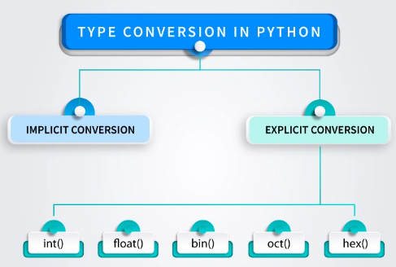
Type casting (inputOutput.py)
Process of converting one datatype to another
int()
float()
str()
bool()
list()
tuple()
set()
dict()

Slide 23
Hands on
Assignment 5: Accept 2 numbers from user add them, print them.
Assignment 6: Add an integer and a float, print result and type of result
Assignment 7: Accept a float value from console typecast it to float and print its square
Assignment 8: Add a string and a number, print result and type of result

Slide 24
Hands on
Assignment 9: Calculate area of a circle – constant PI = 3.14
Assignment 10: Objective : Calculate savings of a person
Input:
Prompt the user to enter their monthly income (as a float).
Prompt the user to enter their total monthly expenses (as a float), which include rent, groceries, utilities, and other expenses.
Calculation:
Calculate the total savings by subtracting the total expenses from the income.
Calculate the percentage of income saved and the percentage of income spent.
Output:
Display the total savings.
Display the percentage of income saved and spent, formatted to two decimal places.

Slide 25


Slide 26
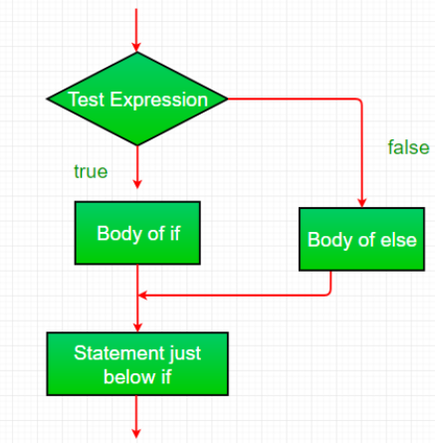
Conditional statements (ifElseControlStructure.py), (elif.py), (nestedifElse.py)
Fundamental control structure used to make decisions based on conditions
Evaluates to ‘true’ or ‘false’
If else condition
If – elif condition
Nested if-else condition

Slide 27
Operators (Operators.py)
Special symbols or keywords used to perform operations on variables and values
Arithmetic Operators
+, -, *, /, %, //, **, BODMAS
Assignment Operators
=, +=,-=,*=,/=,%=,**=,//=
Bitwise Operators
&,|,^, ~, <<,>>
Logical Operators – Boolean values
and, or, not
Comparison (Relational) Operators
==, !=, >,<, >=, <=
Membership Operators
in, not in
Identity Operators
Is, not is
Ternary Operator
‘value_if_true’ if condition else ‘value_if_false’

Slide 28
Hands on
Assignment 11: Implement all comparison operators
Assignment 12: Build a calculator for +, -, * and / operations using if and else condition statements

Slide 29
Hands on
Assignment 13: Build a program that calculates the ticket price based on the age of the customer.
Input: Prompt the user to enter their age.
Logic:
Use if-else statements to determine the ticket price based on age:
Under 5 years: Free
5 to 12 years: Rs 5
13 to 60 years: Rs 10
Over 60 years: Rs 7
Use nested if-else statements if necessary for more granular control.
Output: Display the ticket price based on the user's age

Slide 30
Hands on
Assignment 14: Create a program that determines whether a given year is a leap year.
Input: Prompt the user to enter a year (integer).
Logic: A year is a leap year if: It is divisible by 4, and It is not divisible by 100 unless it is also divisible by 400. Use nested if-else statements to implement this logic.
Output: Display whether the year is a leap year or not

Slide 31
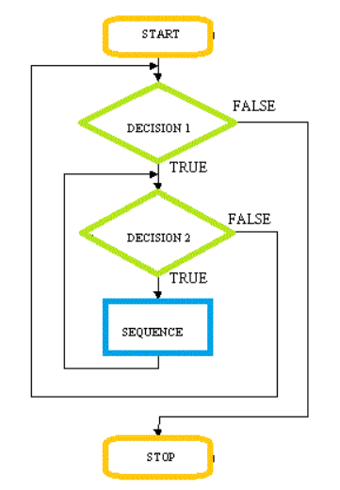
Loops (forLoop.py), (whileLoop.py)
Execute a block of code repeatedly
Execute for specific number of times - for loop
Iterate over a sequence (list, tuple, string, range)
Until specific condition is met – while loop
As long as the condition is true

Slide 32
Hands on
Assignment 15: Factorial of a number: using for loop, while loop
Assignment 16: Write a program to calculate the sum of the digits of a given positive integer.
Input: Prompt the user to enter a positive integer.
Logic: Use a for loop to iterate through each digit of the number and calculate the sum.
Output: Display the sum of the digits.
Assignment 17: Write a program to generate and display the multiplication table of a given number up to 12.
Input: Prompt the user to enter a number.
Logic: Use a for loop to calculate and display the multiplication table for the number.
Output: Display the multiplication table.

Slide 33

Debugging
Debugging helps identify
Syntax Errors
Runtime Errors
Logical Errors
Infinite Loops
Print Statements
Use Debugger
Set Break point
Step through code line by line
Inspect variables

Slide 34

Loop control statements (breakStatement.py)
Break – exits loop completely
Continue – skips current iteration

Slide 35
Hands on
Assignment 18:
Create a simple guessing game where the user has to guess a secret number. The game continues until the user guesses the correct number, at which point the loop should terminate using break.
This should continue until the user gets 10 chances.

Slide 36
Hands on
Assignment 19: Develop a program that simulates an ATM withdrawal process.
Input: Prompt the user to enter their account balance and the amount they wish to withdraw.
Logic:
Check if the withdrawal amount is greater than the account balance. If so, display an error message.
If the withdrawal amount is valid, subtract it from the balance.
Ensure the withdrawal amount is a multiple of 10 (as ATMs typically dispense money in multiples of 10).
Output:
Display the remaining balance if the withdrawal is successful.
If not, display an appropriate error message (e.g., "Insufficient balance" or "Amount must be a multiple of 10").
Check if user wishes to withdraw more money, else exit

Slide 37
Hands on
Assignment 20: Write a program that evaluates the strength of a user's password based on specific criteria
Input: Prompt the user to enter a password.
Logic: Evaluate the password based on the following criteria:
Length of at least 8 characters.
Contains both uppercase and lowercase letters.
Includes at least one numeric digit.
Includes at least one special character (e.g., !, @, #, $, etc.).
Use nested if-else statements to check each criterion and determine the strength of the password.
Output:
Display one of the following messages based on the criteria met:
"Weak" if the password meets only one criterion.
"Moderate" if the password meets two or three criteria.
"Strong" if the password meets all four criteria.

Slide 39
Thank You !!

Slide 40
Homework
Assignment 1: Objective: Create a program that converts inches to feet, meters and centimeters and continue until the user wishes to
Input:
Prompt the user to enter a value (float) and the unit of measurement (e.g. inches).
Prompt the user to select the target unit for conversion
Prompt the user to press ‘Yes’ or ‘No’ to repeat
Calculation:
Convert the input value to the target unit using appropriate conversion factors.
Use typecasting where necessary to handle different types of input.
Use a while loop to repeat
Use break statement to stop calculations one user enters ‘No’
Output:
Display the converted value along with its unit.
Continue until the user presses No.
Conversion Options:
Inches to feet, meters, and centimeters.

Slide 41
Homework
Assignment 2: Build a calculator for +, -, * and / operations using if and else condition statements
Assignment 3: Print a Fibonacci series of numbers starting from 2 go until 100

